Slide 1
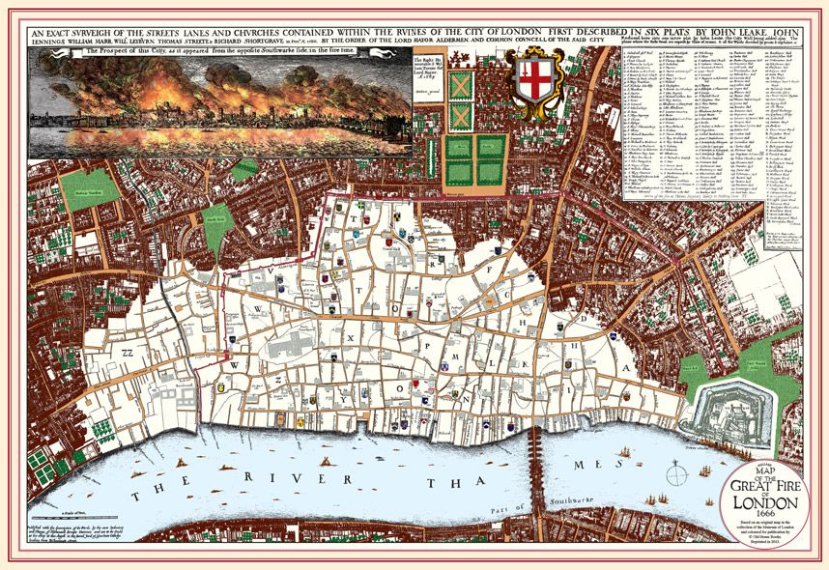


HISTORY AND POLITICS FORTNIGHT 2021
What and when? | More details….
Wednesday 10th November2021”Ethelred: the Birth of a Nation” – an exciting talk” by Mr Ian Davidson | Suitable for Year 7s and Year 11s – but open to anyone. Come to the Library at lunch to listen to this passionate and lively talk by Mr Davidson! Open to all year groups at lunch!
Thursday 11th November 2021 Re-enactor visit PAVILION at lunch for all. | Year 9 P Band Period 4 in the Pavilion. Register with your teacher, then come to Pavilion. Lunch – all year groups welcome to come have a look and a chat with our re-enactor to see all of their WW1 related items in the Pavilion! Year 9 Q Band Period 5 in the Pavilion.
Friday 12th November Mr Burke’s “Photographs of History” lunchtime in the library | Our favourite headteacher, Mr Burke will host a fascinating talk about the importance of photographs in the 20th century. Are they real or are they fake? Open to all year groups at lunch!
Wednesday 17th November - Alex Chalk visit | Lunchtime discussion about politics, careers and his new role as Under Secretary of State in the Ministry of Justice. This is ideal for Year 11s, 12s and 13s with an interest in politics. But is of course open to anyone! This will be in the Assembly Hall. Year 7s will have an assembly about Parliament on this day. Open to all year groups at lunch!
8th – 19th November 2021 – Year 10 Tutor Group Election | During this fortnight Year 10 will run their own tutor based election campaigns. Each tutor group will vote for one MP to represent a view in their assembly on the 17th November. It could be a school, local or national issue for Mr Burke or Mr Chalk to discuss. This is also part of your PSHE.
Korean War Veteran Talk – Thursday 18th November – LIBRARY at lunchtime. | A veteran from the Korean War will tell his stories of what it was like to be part of the Gloucestershire Regiment’s efforts in a little known conflict. Open to all year groups at lunch!
Dr Catharine Arnold, 15th November at 7pm on ZOOM. | “Pandemic 1918” a talk from an award winning historian who will explore the devastating Flu Pandemic of last century. Dr Arnold has been a frequent speaker at the Cheltenham Literature Festival and Balcarras students can attend this online talk for free. Please let Mr Stoker know if you watch this for a prize. Open to anyone with an interest in History. https://us02web.zoom.us/meeting/register/tZ0ucuqqqT4tGdNdKY0urm9d0rZsaMpq5IaN
@ BalcarrasHist
Finally – the “History Conversations” competition! Record a podcast or short documentary about a topic of history outside of the curriculum. A relative story? Any relevant topic of interest? There will be cash prizes for KS3, KS4 and KS5. See our examples for clues on what to do on the VLE. Audio submissions must be wav/mp3 format video submissions either wmw, mp4 or a YouTube link.
Send your submissions to mks@balcarras.gloucs.sch.uk
Mr Burke will judge winners 4th January 2022.

Slide 2

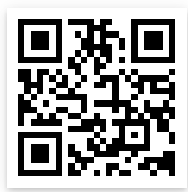


Scan this for an easy to use free online video editor
Scan this for free stock footage to enhance your short documentary
Scan this for a short WikiHow guide on how to make your own podcast!
The “History in Conversations” competition! Record a podcast or short documentary about a topic of history outside of the curriculum. See our examples for clues on what to do on the VLE. Audio submissions must be via wav/mp3 format video submissions either wmw, mp4 or a via YouTube link.
A relative’s story?
African Kingdoms?
A particular battle?
An inspiring figure?
The history of a different country?
Any topic from outside our curriculum!
Send your submissions to mks@balcarras.gloucs.sch.uk
Cash Prizes for KS3, KS4 and KS5 entries.Mr Burke will judge winners January 2022.

