Slide 1
649 pupils carried out a survey on your opinions on Climate Change in May 2021, here is a Summary of what we found Out.
Notes:
1

Slide 2
Summary of Climate Change Survey
1. Pupils at Balcarras are motivated; 649 pupils, (93% are concerned or somewhat concerned about climate change)
2. Pupils are engaged in climate action (81% of students have taken action at home to address Climate Change) (33% of students have taken some climate in school)
3. Pupils want more opportunities. (Over 62% of younger students want to be more involved, and 70% of 13 year old students say they want to do more).
4. Pupils identified what opportunities they would like. The top changes to motivate people are;
Install more equipment that make it easier to undertake action, e.g. more recycling bins around school (structural changes).
Track results and showcase the positive impact of our actions, for instance how much energy or waste we have saved (more positive communication).

Slide 3
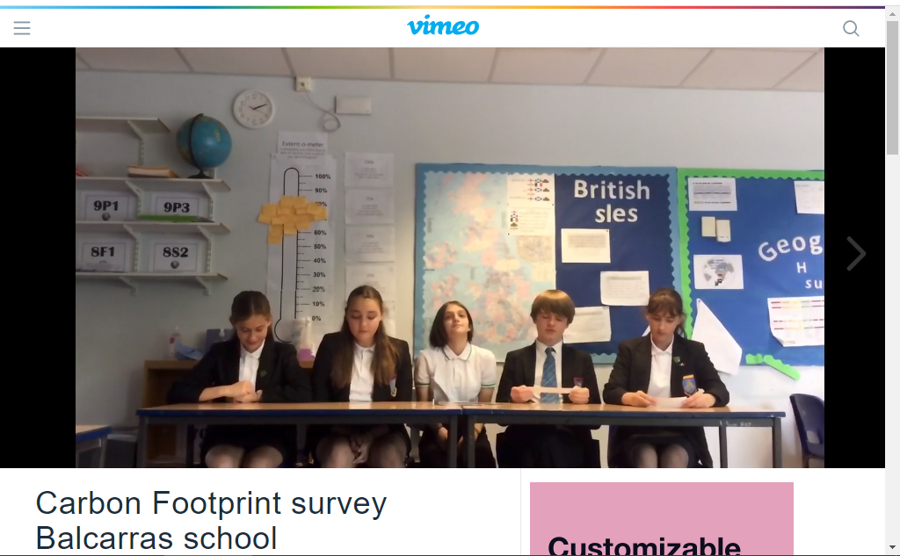

Slide 4
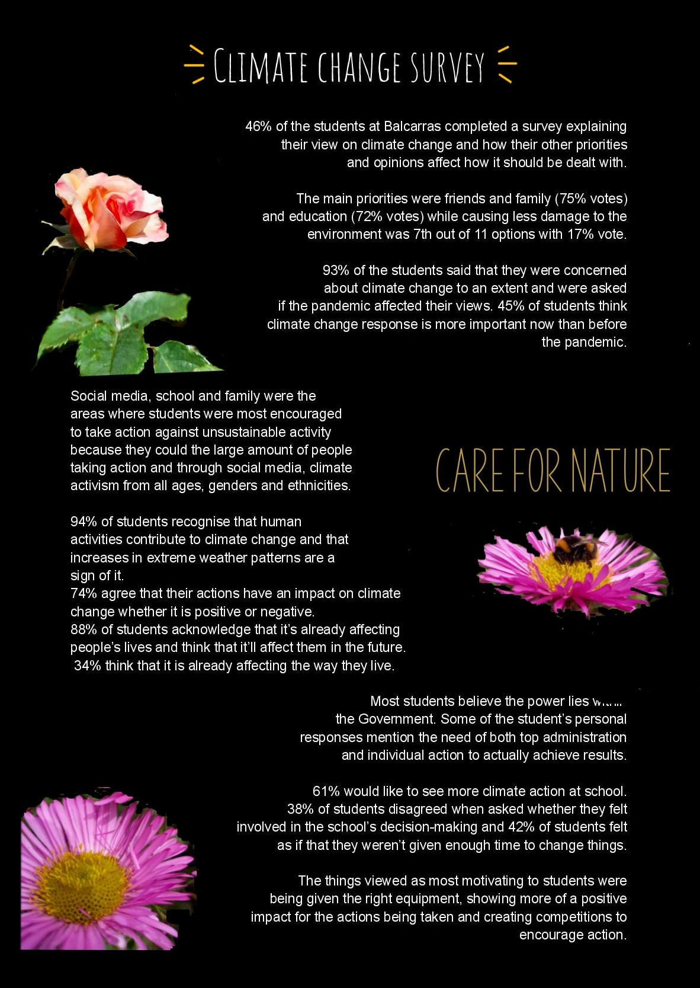

Slide 7
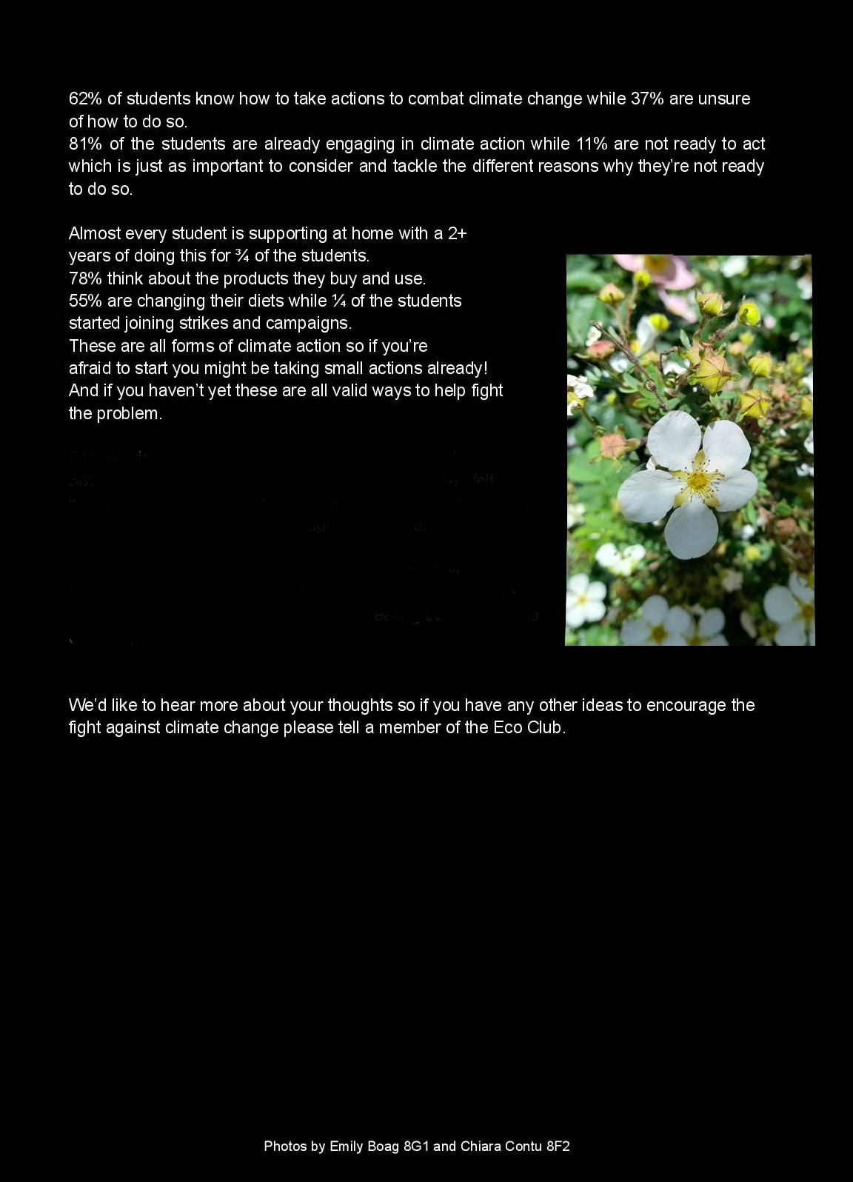

Slide 8
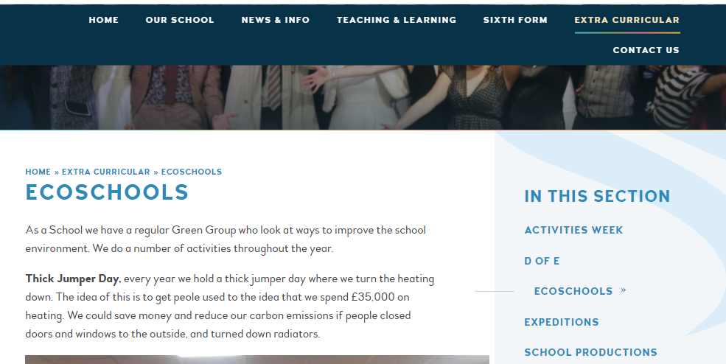
The Full survey can be found on the school website, or for more information contact one of the Eco-club or Mr Pearce

Slide 9

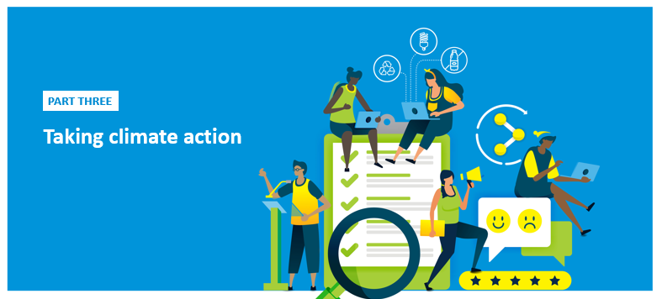
Here are the results in more detail
Congratulations to;
Zac Cowling
Daisy Gillet
And Masie Tweed
Who all won an Amazon Voucher for completing the survey on the VLE

Slide 10

Balcarras School: Climate Action Survey
An insight into students’ views, behaviours and motivations for taking Climate Action
This report presents an overview of data from the Climate Action Survey in three parts:
Part One About the students who participated
Who completed the survey
What is important to our students right now
Part Two Students' views on climate change
What do students think about climate change
How aware are students of what can be done
Where does the power lie to make changes
Part Three Taking Climate Action in school
Are students involved in taking action already
What will motivate more climate action in school!
Share your results
A really important thing to do with all your hard work is to tell school what you have found out. This is so that everyone hears the views of students.
The report is filled with analysis, graphs, and tables from your survey . If you prefer, here is a PowerPoint template on the ICN website to create your own presentation(s).
Notes:
10

Slide 11
PART ONE
About the students who participated
Notes:
11

Slide 12


Who completed the survey?
All students were given the opportunity to do the survey.
46% of students completed it in March and April 2021 which is 649 students out of 1409 students on roll.
That 649 students completed the survey is a massive return rate especially with lockdown uncertainties at the time.
54% of students didn’t complete the survey and they aren’t included in this report analysis as we don’t know about their views. They shouldn’t be forgotten, however and your work on climate action in school will start to bring them onboard.
Students completing the survey
46% YES
54% NO

Slide 13




Breakdown of who completed the survey
Gender Breakdown
Ethnicity breakdown
88%
White - English / Welsh / Scottish / Northern Irish / British, Irish, Gypsy or Irish Traveller, Any other White background.
Female
Male
Non-binary
Prefer not to say
51%
45%
2%
2%
5%
Mixed / Multiple ethnic groups - White and Black Caribbean, White and Black African, White and Asian, Any other Mixed / Multiple ethnic background
Age Breakdown
4%
Asian / Asian British - Indian, Pakistani, Bangladeshi, Chinese
1%
Any other Asian background - Black / African / Caribbean / Black British African Caribbean, Any other Black / African / Caribbean background
1%
Other ethnic group - Arab, Any other ethnic group
2%
Prefer not to say
All ages and five ethnicities across school are represented in the survey (2% preferred not to say). The ages most represented were students aged 17 years then students aged 13 years. More females responded than others.
Notes:
13

Slide 14

What is most important to students now?
When students were given choices about what is important to them right now, two clear priorities emerged: friends and family (75%); education (72%). Other priorities are shown in the graph (left).
As the survey was carried out during COVID students were asked if the pandemic has changed how they think about what’s important to them. Students said:
The greatest changes have been thinking about health and wellbeing (85% said ‘more important’) and friends and family (83% said this was ‘more important’ to them).
Education (61%) and the economy (47%) have also been thought of as, ‘more important’.

Slide 15
PART TWO
Students’ views on climate change
Notes:
15

Slide 16

Where do students learn about climate change?
Where do students hear climate change talked about the most?
Social media, charities and school were the top 3 areas which inspire students to get involved in climate action. Social media and school were also the top sources of information, shown left.
Over a third of students wrote further information about who has made a difference to their thinking about climate change. Again, school and teachers, geography and science in particular, have been a major influence alongside these high profile names:
Teachers (21% of students specifically mentioned)
David Attenborough (20%)
Greta Thunberg (19%)
"Social media because of the amount of people who agree with the posts that are being made, and the facts and information that come with the posts that i didn't know about before."
“The teachers at school if it weren’t for them I wouldn’t have known anything about it.”
"Greta Thunberg provides a voice for young people, and has also brought to my attention that change needs to happen now in order to have any hope of a climate change free future."
Notes:
16

Slide 17
How is climate change viewed?
How concerned are students about climate change?
The survey has shown that almost all students (93%) are concerned or somewhat concerned about climate change. Just 1% of students said they are not all concerned.
When we asked if there have been changes because of the pandemic about what’s important to them:
Students said they’ve either given as much thought as before (42% said ‘the same’) or more consideration to climate change: 45% students said they now think it’s ‘more important.
Buying things was either thought of the same as before (36%) or was given less importance (42% said ‘less important’).
Travel created the most evenly divided responses with the same number of students now thinking travel is more important (39%) as those now thinking it is less important (38%).
Notes:
17

Slide 18
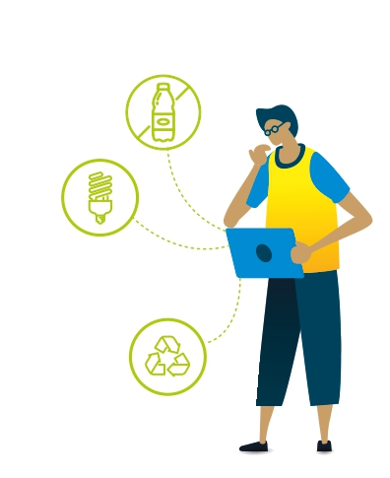
Do our students have an awareness of
...our impact on climate change?
There is a high acceptance of the impact of human activity on climate change, and the implications for the world:
Acceptance of the impact of human activity on climate change was always above 90% of students and rose to 100% of 18 year olds.
Just 0.5% of students (these were all boys) disagreed or strongly disagreed that emissions are caused by human activity.
Whilst almost all students recognised the seriousness of problems,
Fewer students (74%) thought their everyday choices will have an impact:
The age group that most strongly disagreed or disagreed with this statement were students aged 16 years (11%).
More females (80%) and students identifying as non-binary (87%) than males (67%) thought that their everyday choices will have an impact on climate change.
94%* thought emissions are caused by human activity & contribute to climate change.
93% thought increases in extreme weather patterns, intensified droughts, shrinking ice caps are all signs of climate change;
74% thought their everyday choices will have an impact on climate change, in either a positive or negative way.
*% given for these ‘awareness' stats is of those students who ‘strongly agreed’ to ‘agreed.’
Notes:
18

Slide 19
Do our students have an awareness of
...how climate change affects people?
Whilst climate change is widely recognised to be happening now, how it affects us is seen more as a future issue.
In response to the statement, ‘Climate change is already affecting my life and the way I live’:
Around one third of students (34%) either agreed or strongly agreed.
A quarter of students (26%) disagreed or strongly disagreed that climate change is affecting their lives already. This was expressed by more boys (34%) than others.
Slightly fewer (30%) students said, ‘I neither agree nor disagree.’ Students at 15 years old were most unsure (47% gave this response).
However, students were much more sure that climate change will affect their lives and the way they live in the future:
Less than 2% students of all ages disagreed that climate change will affect their lives in the future.
This was already agreed/strongly agreed by many at 11 years (79%).
90% students aged 18 agreed or strongly agreed with this statement.
88%* of students thought climate change is already having a negative effect on people's lives around the world.
34% of students thought climate change is already affecting their own life & the way they live.
86% of students thought climate change will ‘affect my life and the way I live in the future’.
*% given for these ‘awareness' stats is of those students who ‘strongly agreed’ to ‘agreed.’
When asked to compare the sense of urgency students felt over COVID 19 with our response to the Climate Emergency, very many thought the difference is that climate change is a gradual process whereas COVID has been “quick and recognizable”.
Notes:
19

Slide 20
Do our students have an awareness of
...individual action to help combat climate change?
When asked the question, ‘Are you aware of the individual actions you could take to help combat climate change?:
62% of students have a good knowledge of individual actions to take.
37% of students say they know some things but are generally unsure.
This means that although a fantastic 81% of students are taking climate action (as shown on slide 15) over a third of students (37%) are still uncertain about steps they can take to combat climate change.
Age comparison: Are students aware of the individual actions they could take to help combat climate change?
71% students aged 11 years have a good knowledge of individual actions to take – the highest of any age group. Fewer students at 16 years said they have good knowledge of what I can do (54%), rising again by 18 years (69%).
Notes:
20

Slide 21
Where do students believe power lies?
Who do students believe has the most power to change the course of climate change for the better?
The greatest number of students by far (81%) thought that the Government has the power to change the course of climate change for the better. This, and the importance given to 'Businesses & Corporations' and 'Every individual', is reflected in the comments below – just some of many similar responses.
“I believe it requires both a bottom up (individuals) and top down (governments and companies) to tackle it.”
“The government and Businesses/Corporations have huge amounts of power and wealth. They have the power to enforce change and have the ability to make environmental efforts more accessible (e.g. Japan has a strict recycling system so the whole country overall makes less waste).”
“Because the government controls the country meaning they can spread the word out, if loads of communities came together we could start a green revolution. Also every individual has the power to make a big and helpful impact overtime and as long as that individual has a drive and a passion they can do anything.”
The survey detail shows that climate action has been taking place at home by the largest numbers, however just 7% of students believe that the power to change the course of climate change, for the better, lies with families.
Notes:
21

Slide 22
PART THREE
Taking climate action
Notes:
22

Slide 23
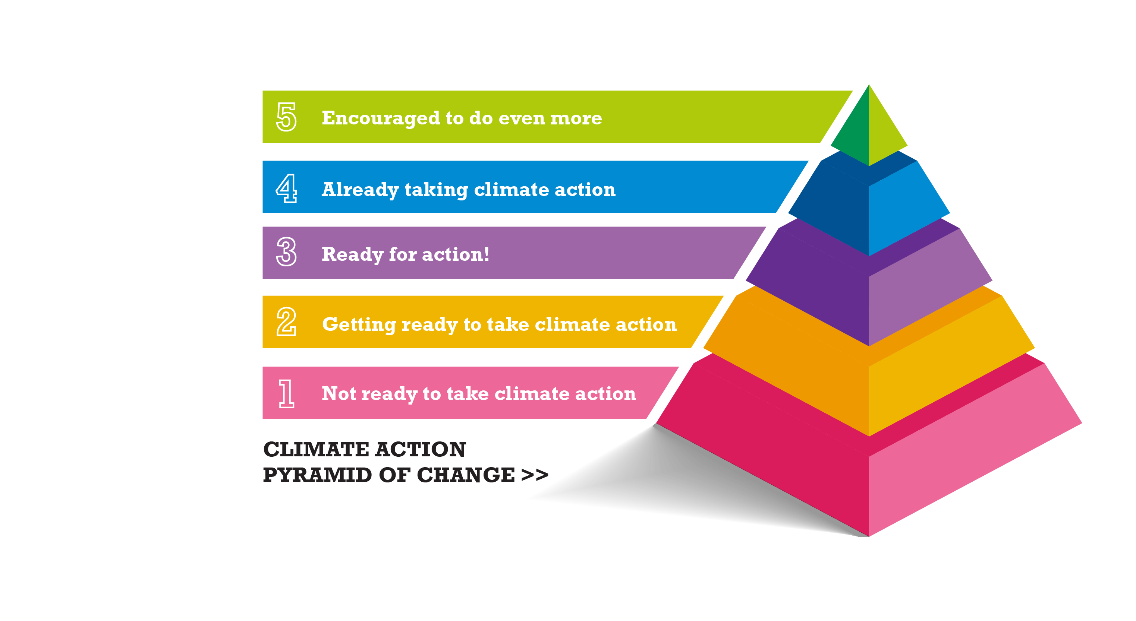
How motivated are students to take
climate action?
81% Taking climate action
What a huge statistic! The brilliant news is 81% of students are already at level 4 and 5 and are engaged in climate action.
8% Ready for action
8% of students are at level 2 & 3. These students would like to undertake climate action but are either unsure of what to do or haven’t gotten round to it yet - they are either ‘getting ready’ or ‘are ready’ to act.
11% Not ready to act
11% of students are at level 1, and this is the harder group to engage with, especially as they have different reasons for not yet wanting to take action.

Slide 24

What climate actions are students already taking?
Data given is only from the students that said they were acting (81%).
So many students are already taking action and two clear and established areas emerged:
Almost every student that is acting (97%) is supporting action at home. This is a well-established (2+ years) way to take action for three-quarters of these students.
Over three-quarters of students (78%) think about the effect of what to buy and use.
More recently, and involving fewer students so far:
More than half (55%) students are changing diets, and for half of these students, this began in the last year.
A quarter (25%) students joined strikes or campaigns, mostly in the last six months.
Around one third (33%) of students who have taken action have supported action in school, whether that’s as part of an eco-team or involvement in reducing energy or waste.

Slide 25
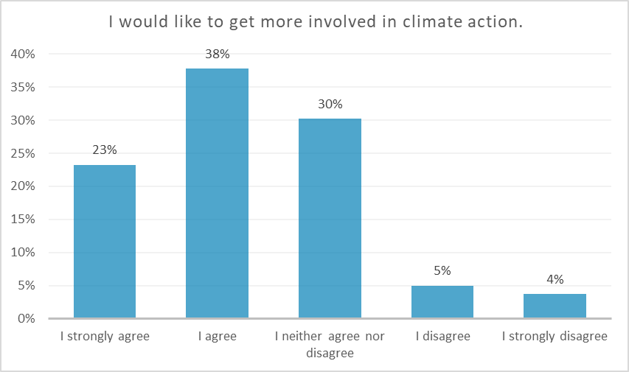
How do students see climate action in school?
61% would like to get more involved in climate action.
Nearly two-thirds (61%) of all 649 students who completed the survey said that they would like to get more involved in taking climate action.
This is a great response and in fact, less than 10% students on average indicated that they would not want to get more involved.
Over 62% of younger students want to be more involved, and 70% of 13 year old students say they want to do more.
Boys were less likely to say they agreed and strongly agreed they would like to get more involved (46%) than girls (73%), non-binary (80%) and those who preferred not to give a gender (78%).
Under a third of students (30%) neither agreed nor disagreed, and this group could well be encouraged to get involved!
Notes:
25

Slide 26
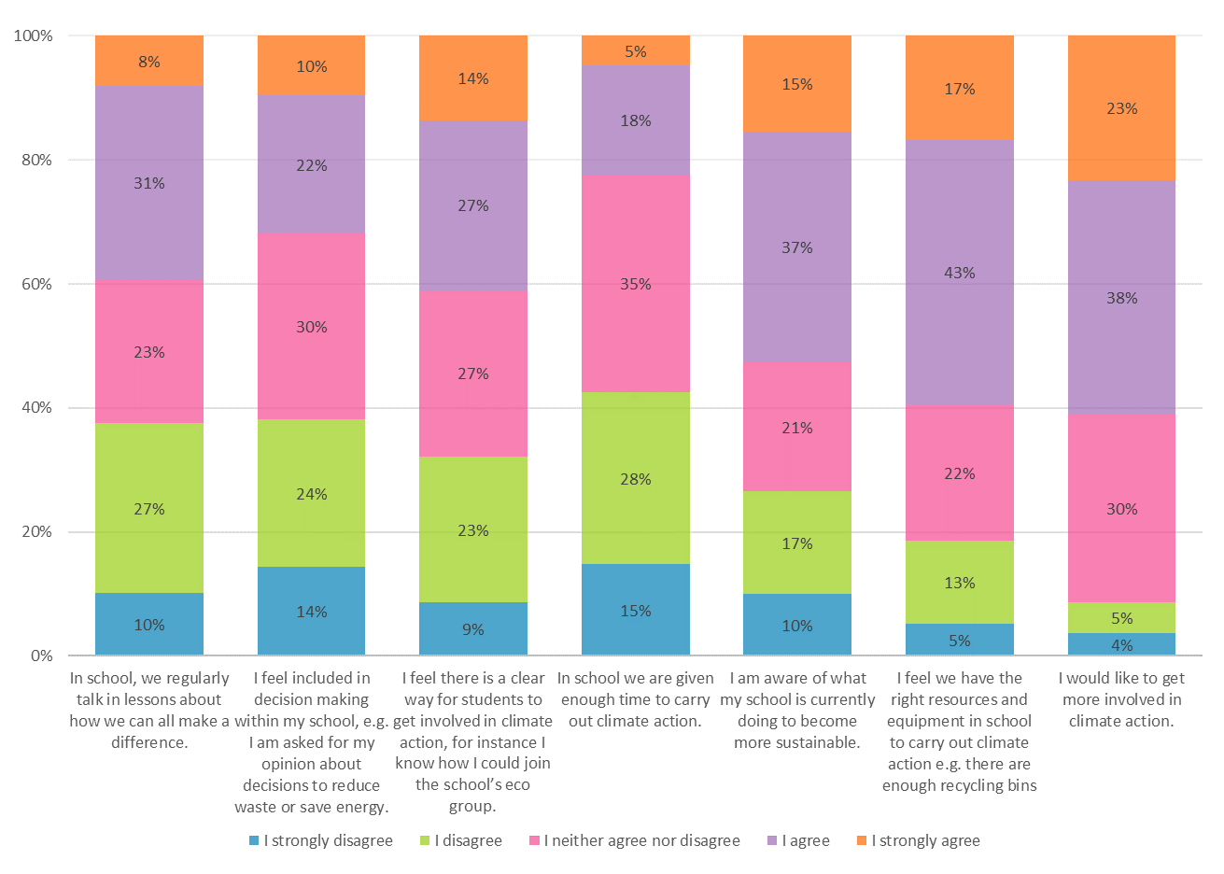
How do students see climate action in school?
Some very positive results for school are that:
Well over half (59%) of students felt that school has the right resources and equipment to carry out climate action.
Over half (52%) students said they are aware of what school is already doing to become more sustainable.
Just over 40% students said that they feel there is a clear way for students to get involved in climate action, for example by joining an eco-group
Other areas were less clear cut:
42% disagreed that students are given enough time to carry out climate action, with one-fifth (22%) students agreeing.
Although 39% agreed or strongly agreed that they regularly talk in lessons about how we can all make a difference, almost as many students (39%) disagreed or strongly disagreed.
38% disagreed that they feel included in climate action decision-making compared to 32% who agreed.
Notes:
26

Slide 27

Motivating action in school
In writing the survey, we used research to identify different approaches (see next slide) that might motivate students to undertake climate action. The top approaches (shown right) clearly show that students saw the value in:
Making changes easy, whether that's more equipment or introducing new menus.
Showing positive results, and rewards and competitions to encourage even more action.
What might motivate action included:
Making sure sustainability is covered in every lesson, and
Making the links between climate change and other issues.
Fewer students were convinced that they would be motivated by careers guidance on 'green' jobs, or hearing from inspiring people. Least popular was the idea of having student monitors!
Top choices ‘this would motivate me’
Install more equipment that make it easier to undertake action, e.g. more recycling bins around school (structural changes).
Track results and showcase the positive impact of our actions, for instance how much energy or waste we have saved (more positive communication).
Introduce changes that we are not really aware of e.g. mix more vegetarian options into the rest of the canteen menu (structural changes).
Rewards and competitions to encourage action.
Interestingly, students weren't so keen to feed in or influence school rules (33%), although more (39%) thought that having stronger rules could help motivate climate-friendly action in everyone.
Notes:
27

Slide 28
Motivating action in school
Notes:
28

Slide 29

What next?
Insights to support more climate action in school
Such a lot of great information and understanding has come from your survey and here are two ways for you to make the most of them:
Share the results in school: a really important follow-up is to share what you have found out so that everyone, whether fellow students through to the headteacher and governors, can hear the views of so many students.
Use the survey to help more students carry out climate action: our follow up resource, with further detailed analysis of your data, will help you to target more action in school. Let ICN know if you want to move on to the next stage.
Our team will also be drawing together analysis from the different schools survey’s. We're aiming to build the insights into one report and will keep you posted!
Thanks from the ICN team to everyone who took part.
Notes:
29

Slide 30
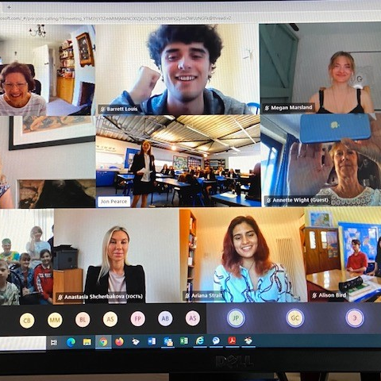
Balcarras & Sochi (Russia)
Pupils at Balcarras have also been having meetings with students in Sochi, Russia to discuss ways to combat Climate Change.
Balcarras Y8 EcoClub and 6th form Russian language students have decided to work on a collaborative recipe book and to carry out some carbon emissions monitoring.

Slide 31
Summary
1. Our pupils are motivated; 649 pupils, almost half of the school completed survey, almost all students (93%) are concerned or somewhat concerned about climate change
2. The best news is 81% of students are engaged in climate action
Around one third (33%) of students who have taken action have supported action in school
3. Pupils want more opportunities. Over 62% of younger students want to be more involved, and 70% of 13 year old students say they want to do more.
Well over half (59%) of students felt that school has the right resources and equipment to carry out climate action.
Over half (52%) students said they are aware of what school is already doing to become more sustainable.
42% disagreed that students are given enough time to carry out climate action
38% disagreed that they feel included in climate action decision-making compared to 32% who agreed
4. Pupils identified what opportunities they would like. The top changes to motivate people are; Install more equipment that make it easier to undertake action, e.g. more recycling bins around school (structural changes).
Track results and showcase the positive impact of our actions, for instance how much energy or waste we have saved (more positive communication).
Introduce changes that we are not really aware of e.g. mix more vegetarian options into the rest of the canteen menu (structural changes).
5. Some pupils are unsure of what to do. 37% of students are unsure of individual actions to take
Only 58% of people felt that individuals had the power to make changes, most believed it was up to governments and corporations.

