Slide 1

Secondary Ready
Becoming Secondary Ready
Helping you guide your child through the secondary transition process

Slide 2
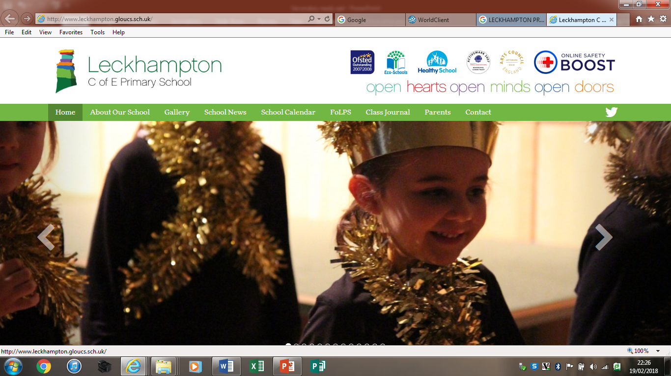

Mrs Cath Saunders
Design Technology
Year 7 tutor
Year 6 / 7 Transition
Mrs Catherine Williams
SENDCO
Miss Amelia Noble
English
Year 7 tutor
Mrs Rachel Curtis
SENDCO
Emily Vincent
Educational Psychologist

Slide 3
How to be a parent in 2018…..
Make sure your children’s academic, emotional, psychological, mental, spiritual, physical, nutritional and social needs are met while being careful not to over stimulate, under stimulate, improperly medicate, helicopter or neglect them in a screen free, processed foods free, GMO free, negative energy free, plastic free, body positive, social conscious, egalitarian but also authoritative, nurturing but fostering of independence, gentle but not overly permissive, pesticide free, two storey, multi lingual home, preferably in a cul-de-sac with a garden and 1.5 siblings, spaced at least two years apart for proper development, and also don’t forget the coconut oil
How to be a parent in nearly every other generation before ours…..
Feed them sometimes

Slide 4
Key skills for education and life

Slide 5
Key skills for education … and life
Relationship skills

Slide 6

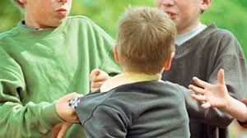
Friendships and relationship skills…..

Slide 7
Sept – 196 pupils joining from ….. Feeder schools
House system
The tutor group
Requests

Slide 8

Friendship groups and meeting new people

Slide 9

Inclusion for all
Prepare your child to meet a wider range of pupils, for example
  Learning difficulties
  Hearing impairment
  Visual impairment
  Physical disability – wheelchair users, adapted furniture/equipment
  Autism/social communication
  Speech & language needs
  Medical conditions – diabetes, epilepsy, Tourette’s etc.
  Different gender orientation
  EAL
  Cultural difference
  Laptops
Talk about acceptance, understanding, kindness, empathy, adapting

Slide 10
Transition for SEND pupils
Information gathering:
EHCP reviews in Y5 and Y6
CS/IGD initial visits highlight pupils
LA ‘flagging’
Focussed SEND meeting with primary feeder schools
Parents invited to meeting
Create Pupil Passport
Initial ideas about support
Additional visits can be arranged
Support on Taster Day
Spread across TGs

Slide 12

Key skills for education … and life
Responsible decision making

Slide 13

Sleep
Approximate hours of sleep needed by children of different ages, as recommended by the Millpond Children's Sleep Clinic.
Age | Amount
9 years | 10 hours
10 years | 9 hours 45 minutes
11 years | 9 hours 30 minutes
12 years | 9 hours 15 minutes
13 years | 9 hours 15 minutes
14 years | 9 hours
15 years | 9 hours
Recommended sleep times from the NHS website: https://www.nhs.uk/Livewell/Childrenssleep/Pages/howmuchsleep.aspx

Slide 14
Poor sleep in teenagers can lead to…
Poor ability to remain alert
Poor ability to sustain attention
Mood swings and emotional difficulties
Tension and anxiety – leading to stress
Becoming hostile and aggressive
Having poor emotional regulation
Being less able to regulate negative emotions
Affect school progress
Affect friendships

Slide 15
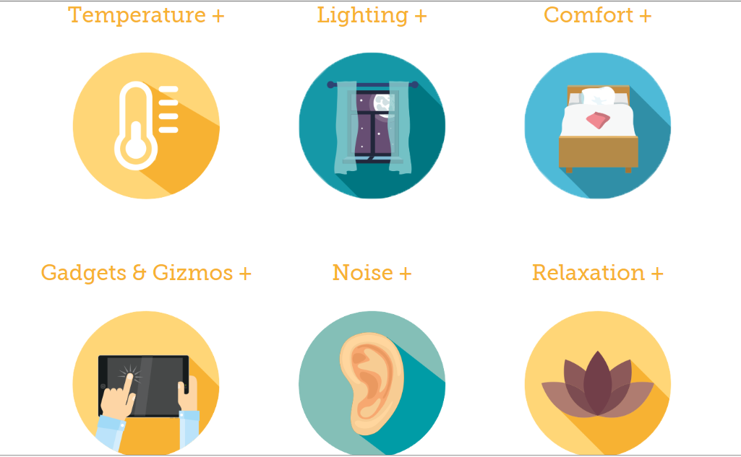
Creating an environment for sleep

Slide 16

Key skills for education … and life
Social awareness

Slide 17
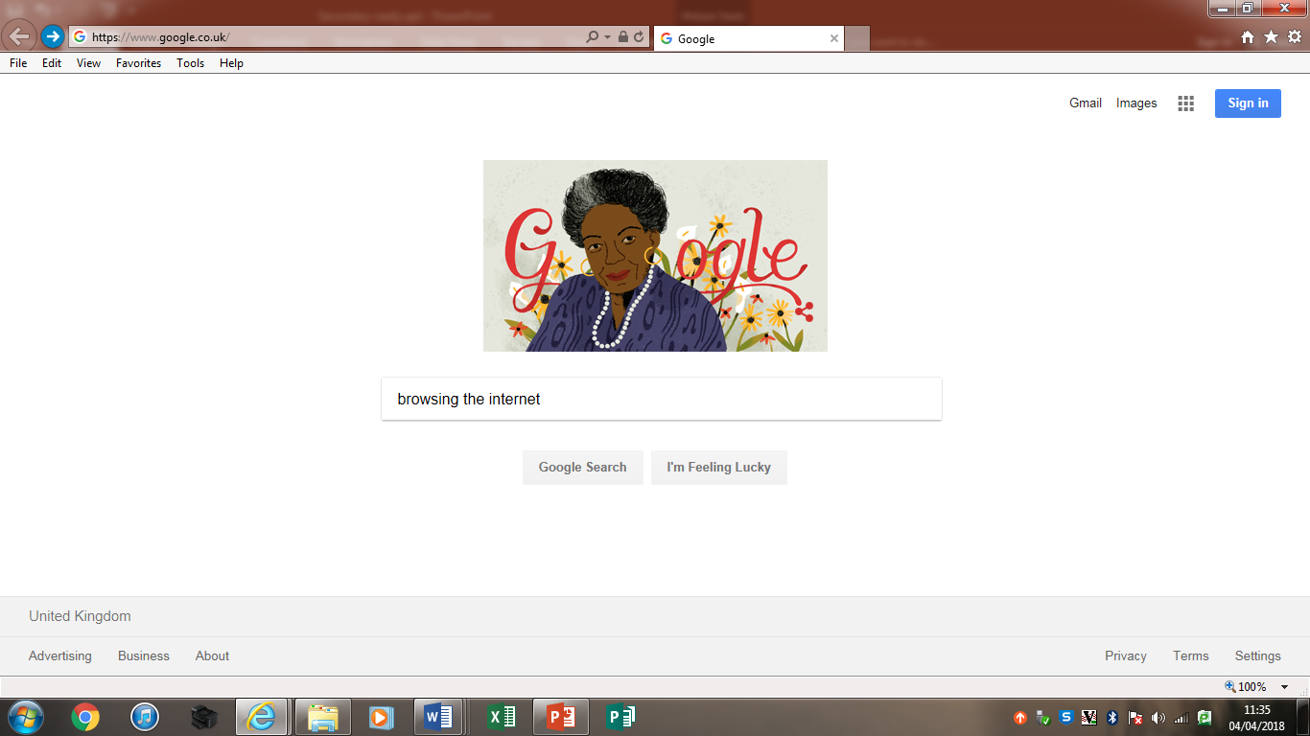



Screen time

Slide 18

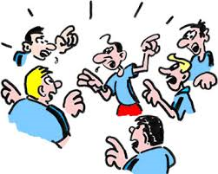


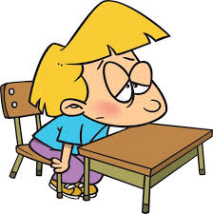


When screen times becomes an issue….

Slide 19
Key skills for education … and life
Self awareness and self management
Emily Vincent
Educational Psychologist
www.educationalpsychologist-glos.co.uk

Slide 20
Resilience
The capacity to cope with life’s challenges and adversities……

Slide 21


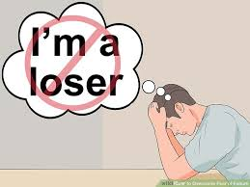

Life can throw things at us..
An F for a test
Illnesses
Accidents
Falling out with others
Setbacks
Challenges

Slide 22



Why is it that people can respond to a crisis in very different ways?

Slide 23
Resilience. What is resilience?
The term resilience comes from the Latin word ‘resilio’ – to jump back
It refers to a person’s capacity to handle environmental difficulties, demands and high pressure without experience negative effects (Kineman and Grant 2011)
Studies since 1970’s (lots!) – considered resilience in terms of individual characteristics such as temperament, intelligence, problem solving skills, stress resistance which would ‘harden’ children and enable them to achieve success. These studies suggested that there was something remarkable about children who overcame great adversity
Researchers have found that protective factors have a stronger impact on children’s development than risk
factors

Slide 24
Resilience. Why is it important?
Having resilience therefore increases a person’s self awareness and self management, aids ability to ‘bounce back’ and protects our mental health.

Slide 25
Q: How can we support our children on this important transition to adulthood?
A: Foster their resilience (increase their ability to ‘bounce back’)
Resilience is learnable and teachable…

Slide 26
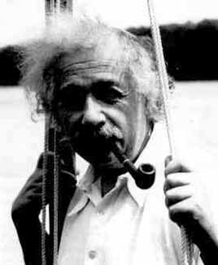
1. People are not born smart
Encourage young people to see intelligence and ability as something they need to work at
People are not born smart
ALL of the most successful people in life will have had to overcome failure
Use role models to illustrate this

Slide 27
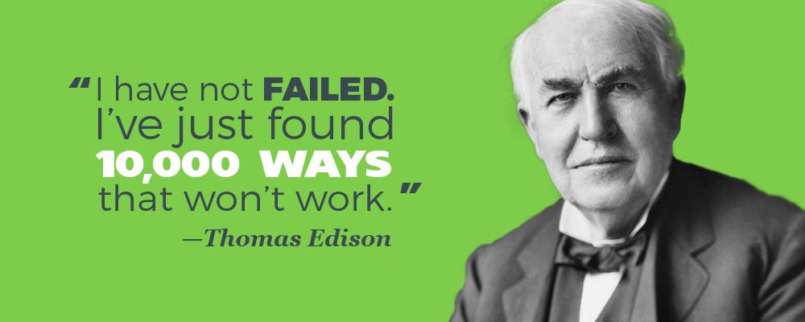
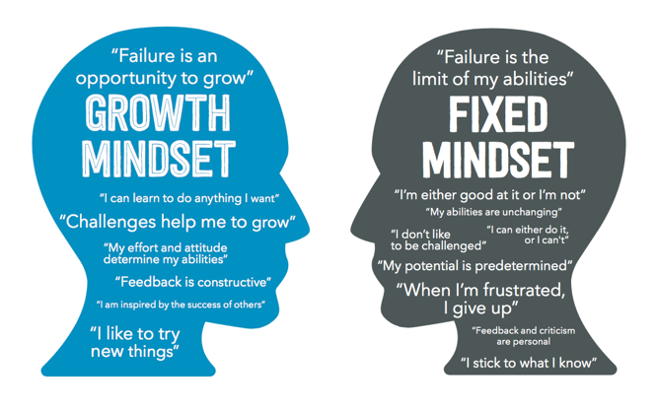
2. Failure often leads to success
Encourage young people to view failure in a different way
Failure is a learning opportunity
Talk about the failures you have overcome. You are a role model

Slide 28
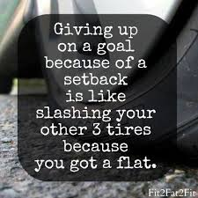
3. Normalise don’t personalise
After a negative experience it is common for young people to think that this type of thing ONLY happens to them
Encourage young people view these setbacks as normal – everybody experiences them
And help them not to think that this is something which reflects badly on them

Slide 29
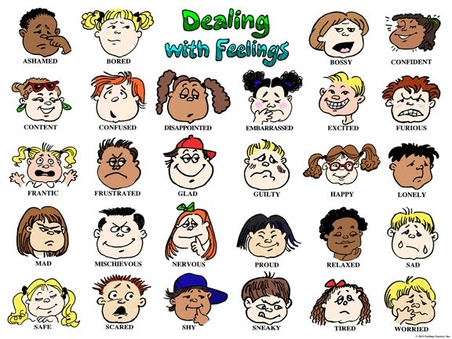
4. Bad feelings are normal
It is human nature to experience negative emotions
Only psychopaths and dead people don’t
Bad feelings are normal
Learning anything worthwhile requires some frustration

Slide 30


5. Bad feelings don’t last
When young people encounter negative experiences they may think that they will ALWAYS feel that way
Research shows that most bad feelings don’t last
Remember to remind young people that these feelings will pass

Slide 31
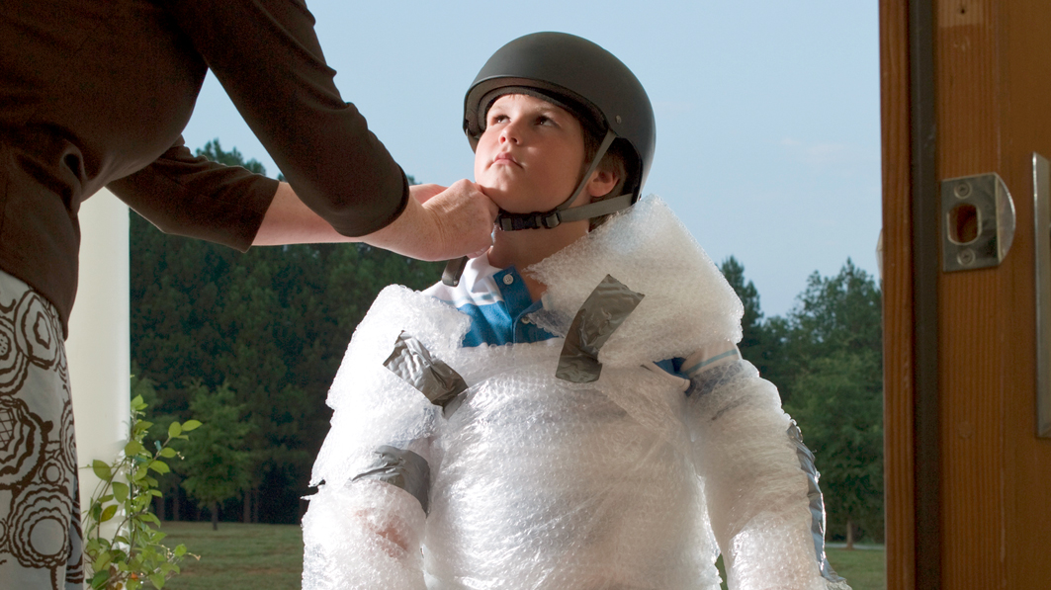
6. Try not to over worry or over protect
Life is full of ups and downs
If you protect young people from them they will not cope when they meet setbacks and will not be able to assess risk
Allow young people to make mistakes, do not bail them out
Overprotection only makes young people more vulnerable and anxious
Show that you trust them by talking through a situation, provide choices and evaluate any mistakes

Slide 32

7. Perfection doesn’t exist
Everyone has flaws, even the most accomplished people (and the people on social media!)
There is no standard for perfection
It is much more important that people try to do their best, rather than be the best
Reward effort not grades

Slide 33
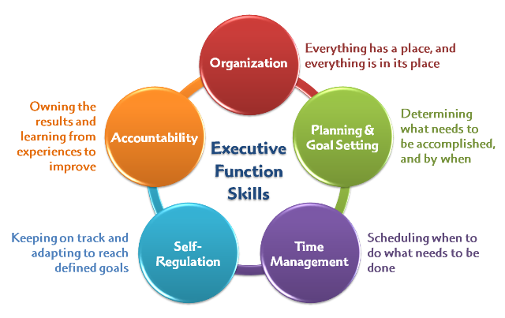
8. Teach young people skills
Young people have an inbuilt need to learn (however lack of confidence, lack of skills or fear of failure, may prevent learning)
You can help young people to learn the skills to help them in life
Teaching executive function skills is essential to learning and life

Slide 34
Summary –building resilience
1. Remember, bad feelings: don’t last; have a purpose; and galvanise us to do things differently
2. Try to normalise young people’s set-backs. Help them to see they are not abnormal in having difficulties in life
3. Help them to see that problems can be solved
4. Encourage young people to keep things in perspective – the problem is usually confined to only one part of their lives
5. Remember the value of humour – laughing can be a great release (but only if it is well-intentioned)

Slide 35
Summary –building resilience
6. Encourage young people to accept responsibility for their actions
7. When reading stories, or discussing events, point out how people manage to overcome difficulties
8. Remember that learning is often frustrating. Encourage young people to persist and believe they can get there
9. Provide support. Help them to see there are people who care about them and can give them help and advice when needed
10. Create a positive environment, that emphasizes the importance of relationships and a sense of purpose: there is more to life than the way they feel

Slide 36
Responsible Decision Making
“It’s a much bigger step for parents than the children themselves…they take it in their stride!”

Slide 37
What our parents think…..
The biggest surprise was how independent they become. They rise to the challenge more than you think they would.
It takes time to get used to the children being more in charge of information flow between home and school.
Don’t worry everything always works out fine!

Slide 38

Before your child starts
Time the journey to school
Be sure your child is clear about what time they are expected to be home and what to do if they are held up for any reason
Make sure they know/have your contact numbers
Work out with your child what time they will need to get up to get to school on time. Work backwards from the time they need to be at school. Include all the things they will need to do
Agree a bedtime for school days with your child that will ensure they get enough sleep
Help your child organise their living space at home so that they have a place for everything to do with school. Try to make sure they have access to a desk, good light and storage space for their school books

Slide 39
Equip them with the tools they will need at home. It can be useful to have spare items so that they can still do their homework if they leave their pencil case at school. A useful home tool kit consists of pencils, pens, rubber, sharpener, crayons, felt pens, ruler, maths equipment (protractor, compass, set-square and calculator), sellotape, glue-stick, paper (lined and plain) and plastic wallets
A box file or stacking system is useful for pupils with organisational problems each file can be labelled with a subject and all books and worksheets can be kept ready to pull out and put in the school-bag when required
A labelled A4 plastic or card folder to take to school for each subject is useful – pupils are given lots of worksheets which they are not used to organising. Folders can hold all work sheets, books etc.
An additional A4 plastic or card folder for finished homework is useful for children with poor memories – they can check it each lesson to see if there is homework to be given in

Slide 40
When they start
If possible, be around for your child for the first few days/weeks and “supervise”. Praise and encourage independence but be ready to offer a helping hand
Decide on responsibilities who does what – parent / child?
Keep your side of the bargain - carry out the tasks you said you would!
Encourage your child to put everything out the night before
Have a system for making sure that clothes are clean and ready – the earlier children start to take responsibility the better, but whoever does it, both parties need to know the system

Slide 41
Teach a routine for ‘emptying their bag’. The subject folders or books are replaced in the system. Any subjects for which homework is required are placed in homework to be done pile. Do this with your child to begin with if necessary, then gradually let them take over. Even when your child “has got it” do “spot checks” every so often
Encourage your child to glue any worksheet/odd bits of paper into their workbook if possible each night – otherwise the sheer volume of bits of paper becomes impossible
When homework is completed supervise the packing of the bag. This is best done the night before
A displayed timetable can be used as a checklist for subject folders and equipment. Get them to write the equipment needed at the top of each day
Encourage your child to check their planner for any reminders/notes each night. It’s usually worth double checking!
If you know your child has food technology on a certain day, check at the beginning of the week if they need ingredients – searching through cupboards on the morning is not to be recommended!

Slide 42
From a tutors perspective…
Eating is important!
Clubs and activities
Have a structured routine at home – homework, bag checking, planner signing
Be properly equipped – write in pen!
Don’t let ‘issues’ develop
Make sure they can do up their shoes
Make sure they can tie a tie!
When they join us – don’t expect them to suddenly undergo a dramatic change (although some of them do!)
They will be exhausted I the first few weeks – bear with them!

Slide 43
Top tips from our pupils…..
Get involved in clubs.
Get involved with everyone surrounding you and try your best in each lesson
Try to make new friends as well as keeping old ones
Do not worry about anything.

Slide 44
Top tips from our pupils…..
The first days were much more relaxed so DO NOT STRESS!
Don’t get stressed about the homework because its gets better the more you do.
Explore new things!
Try hard in all lessons!

Slide 45
Taster day
Opportunity to meet their new tutor group
Meet their tutor and Head of House
See what school is like – learn a little more about Balcarras
Attend lessons in Design and Technology, Art, Science and Languages
Meet the whole year group during break and lunch

Slide 46
What happens next?......
All pupils will be visited in schools by either Mrs Cathryn Saunders or
Mr Ian Davidson
Some will be visited by Mrs Catherine Williams SENCO or Mrs Louise Young
We talk to all the children and answer any questions they may have – even if they are coming on their own
We talk at length with their teachers
We will allocate them in to houses and tutor groups
They are invited to taster day – Wednesday 4th July (not Leckhampton)
You are invited to taster day parents evening – Thursday 5th July – very important event – uniform, meet tutor and house head – important for
all children
Sept 2018 – they will be raring and ready to go!

Slide 47
What you can do next……
Start taking about transition to your child
Start getting involved in Balcarras – familiarity
PTFA Events coming up – Midsummer Music – Friday 22nd June (tickets need to be purchased in advance from school – Friday 22nd June)
PTFA meeting (staff room) – 13th Sept – welcome all newcomers
to meetings
Icebreaker Disco – Friday 14th Sept – for new Yr. 7s and their parents (don’t worry although at school – not in the same venue and you wont be expected to dance!)

Slide 48
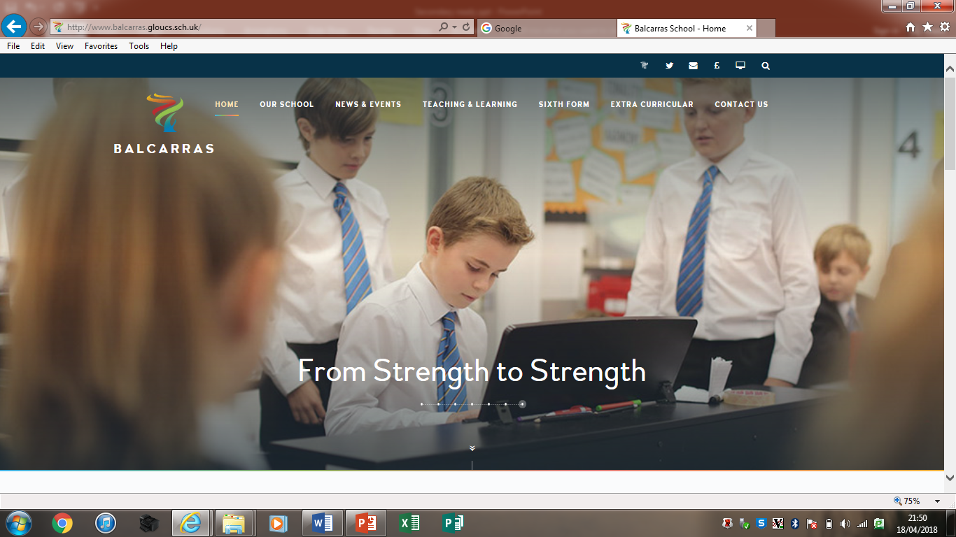
Visit the school website….
www.balcarras.gloucs.sch.uk

Slide 49
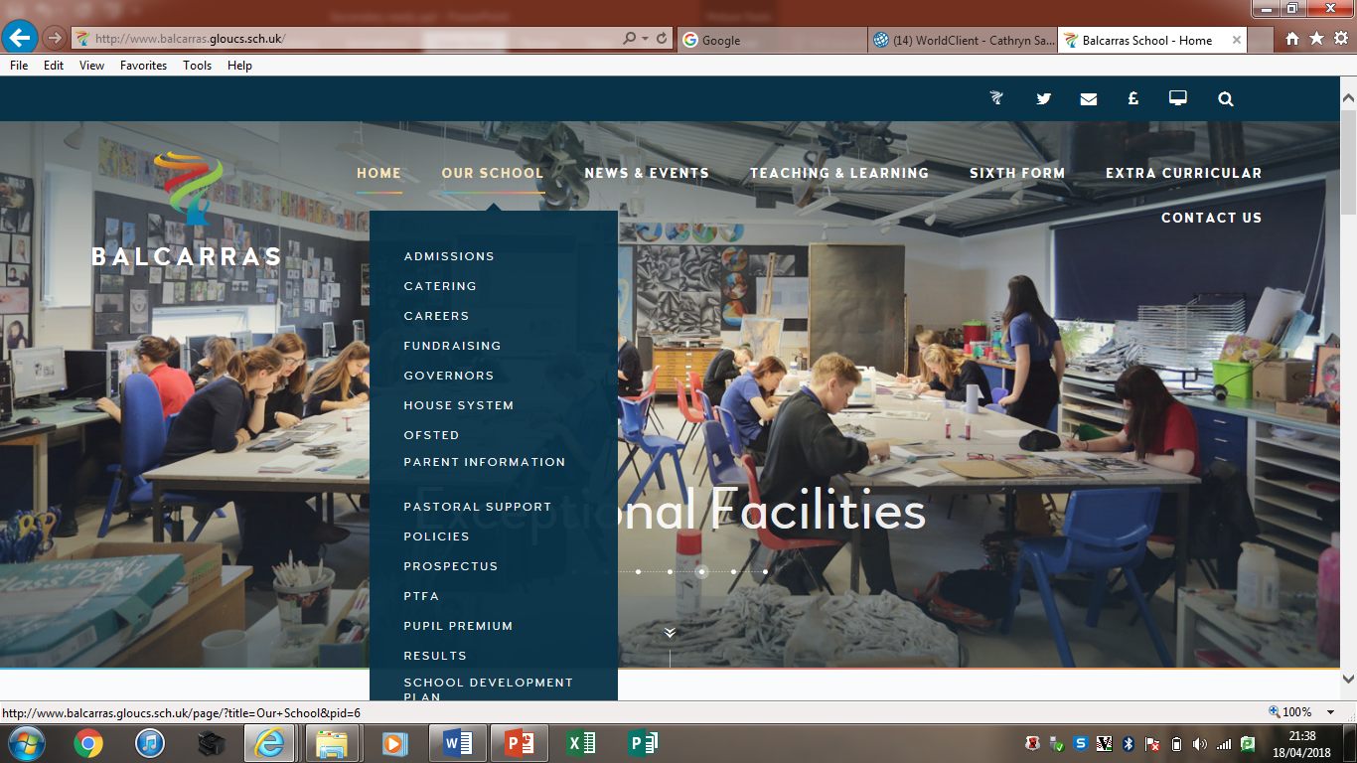
Visit the Pastoral Support section

Slide 50
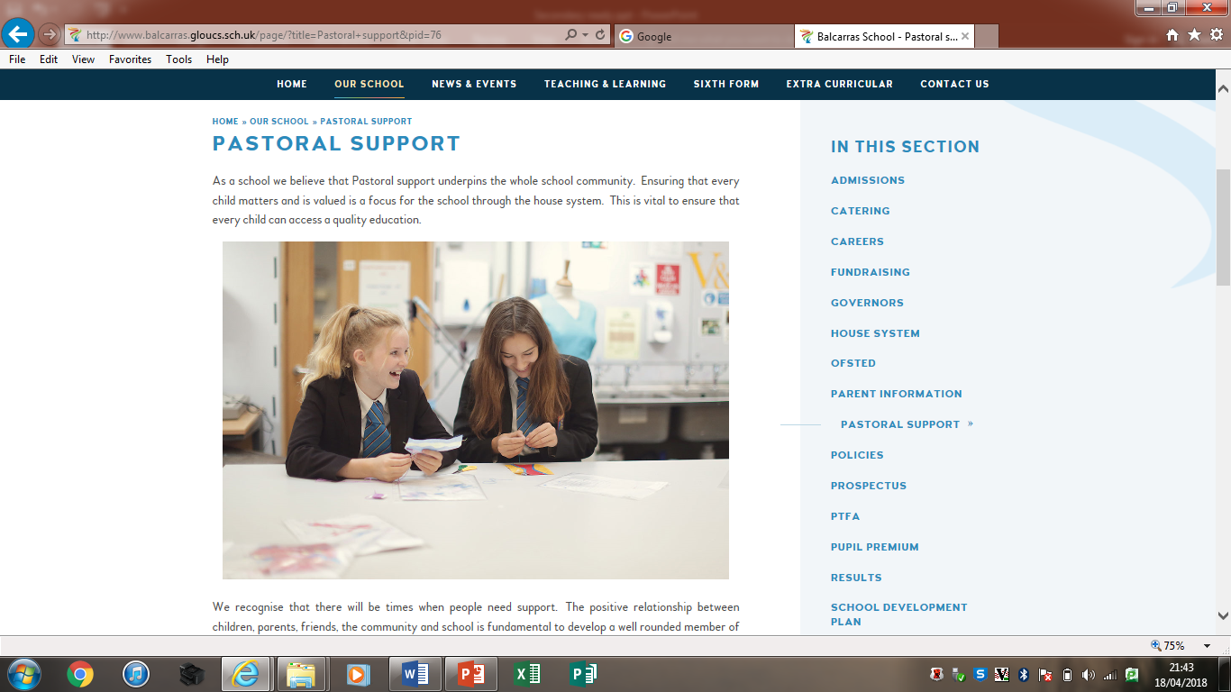


Slide 51
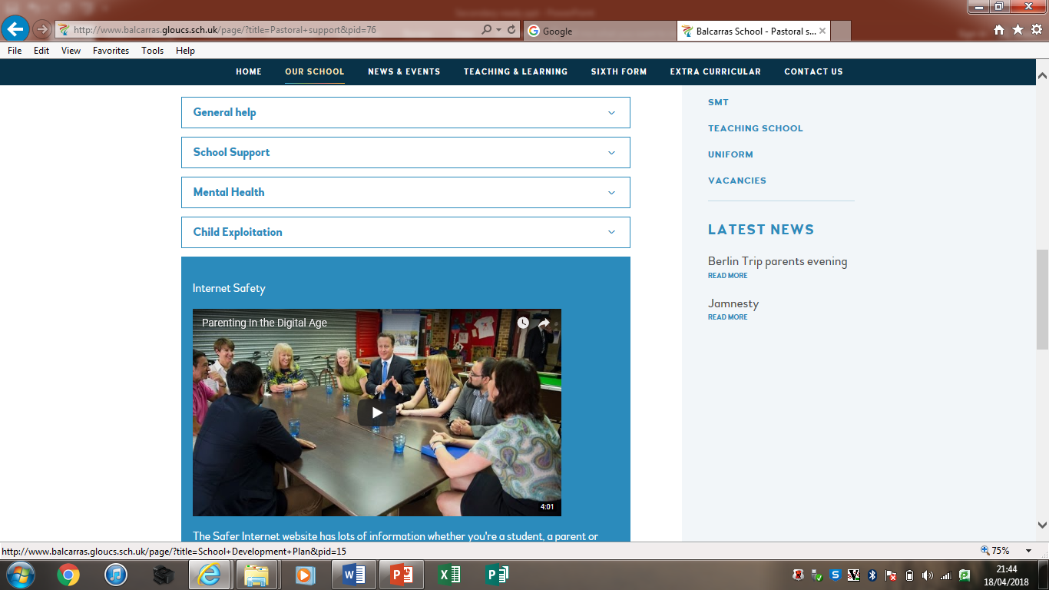

Slide 52
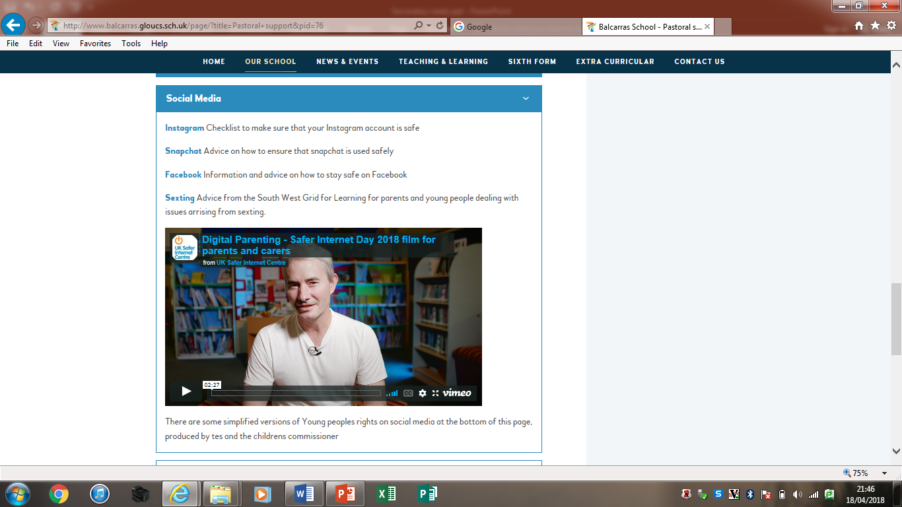

Slide 53


Slide 54
Resources from this evening – pastoral support section – Year 6 Transition

Slide 55
Questions
???????

Slide 56
We hope you have found this evening useful
Should you have any further comments or questions please email cs@balcarras.gloucs.sch.uk
Cath Saunders

Slide 57
What makes a good learner…..
I can do it – positive attitude
Perseverance
Good listener
Takes risks – not being afraid to get things wrong
When things do go wrong they have developed resilience
Always tries their best
Does homework regularly and on time
Able to share ideas and knowledge
Concentrates – is not distracting or distracting
Seeks help when needs it
Is properly equipped

Slide 58
Teach problem solving
Avoid catastrophising
Help the manage emotions
Teach self-care and self-awareness
Accept that change is part of living
Random acts of kindness

Slide 59
Recognise dangers of social networking
Avoid eliminating all risk
Take a break
Keep perspective
Let them make mistakes
Discourage rumination

Slide 60
10 keys to happier living
Giving – do things of others
Relating – do things for others
Exercising – take care of your body
Appreciating – the world around you
Trying out – having a go at new things and not worrying of things do not go to plan
Direction – have goals and work towards them
Resilience – find ways to bounce back
Emotion – take a positive approach
Acceptance – be comfortable with who you are
Meaning – be part of something bigger

