Slide 1

Your logo (delee this if not including)

Slide 2


Slide 3


Slide 4

On the careers pages of VLE / The Careers Team – Call into the careers office or email careers@balcarras.gloucs.sch.uk / AMAZINGAPPRENTICESHIPS.COM/NAW
ANYTIME
Earn as you learn: apprentices are employees too, which means you'll get a salary while gaining work experience. You’ll be learning on the job and applying your new skills in a real work environment.
Nationally recognised training: you'll get training that’s recognised and valued by employers throughout England and the UK.
No student debt: apprentices don’t pay tuition fees and aren’t eligible for student loans, so there’s no student debt to worry about. You’re still entitled to student discounts though and can get an NUS card.

Slide 5

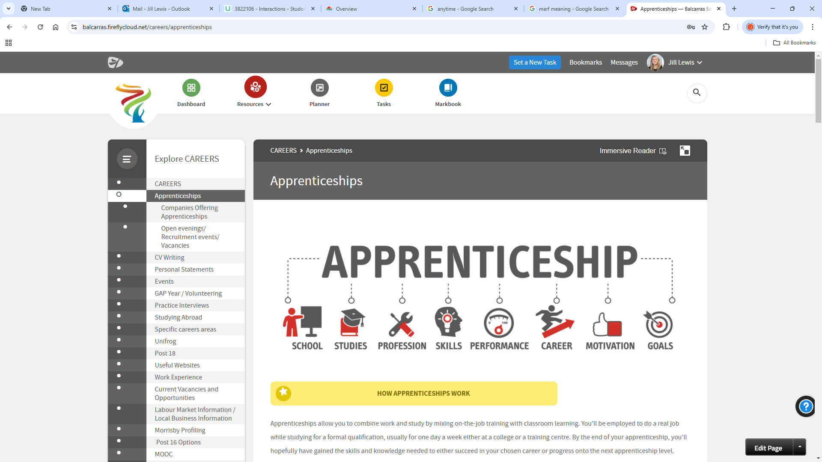
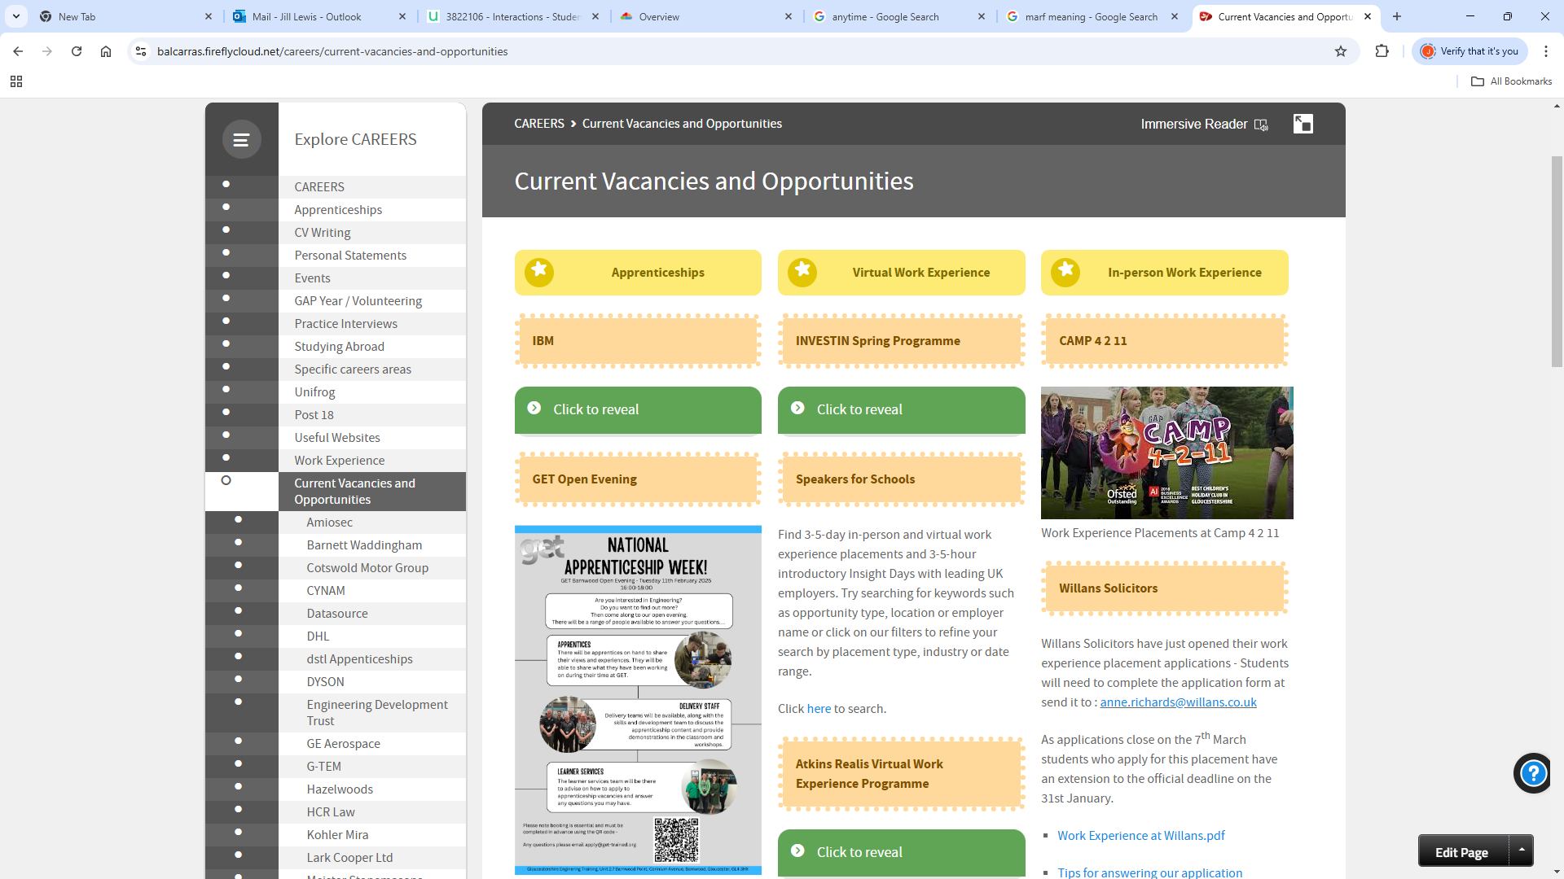
CAREERS PAGES ON VLE
Blank slide for anything else you want to include.

