Slide 1
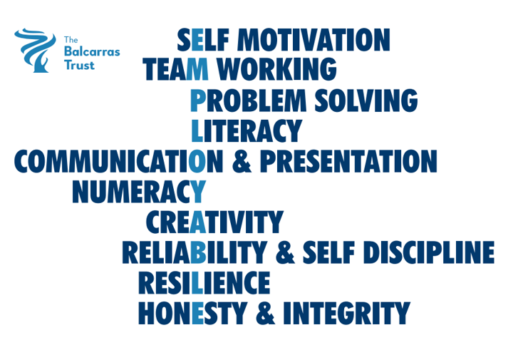
LMI Gloucestershire – October 2025
(source: Glos County Council)
Job adverts:
16698 ↑ 156
↑0.9% in Gloucestershire, ↑2.8% in whole UK
Number of Unemployed:
10715 ↑ 175
2.7% population aged 16-64
What occupations are most advertised?
What are the top five common skills asked for in job adverts?

